Slide 1
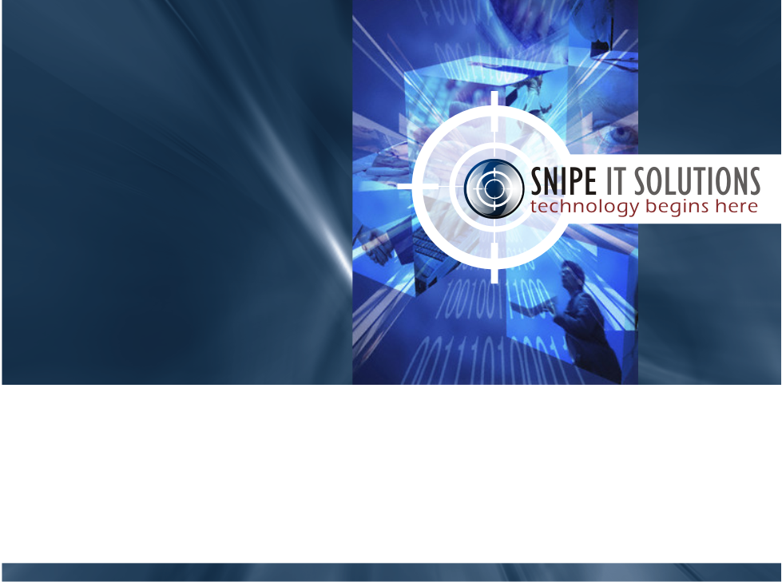
RAVI ROHITH

Slide 2

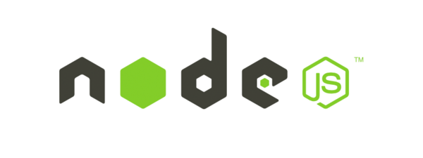

NODE.JS
NPM

Slide 3
CONTENTS
What is Node.Js ?
What is I/O ?
JavaScript V8 Engine
Reasons Node.Js
Node.Js Setup
First Application
Global Objects
What is NPM ?
Tools of NPM
Why, How we use NPM ?
NPM Installation
Package.Json
Publishing NPM Packages

Slide 4
WHAT IS NODE.JS ?
Node.Js is an open source , cross platform runtime environment for server side and networking application.
It is written in JavaScript and can run on Linux , Mac , Windows.
It provided an event driven architecture and a non blocking I/O that optimize and scalability. These technology uses for real time application.
It used Google JavaScript V8 Engine to Execute Code.
NODE.JS = RUNTIME ENVIRONMENT + JavaScript Library

Slide 5
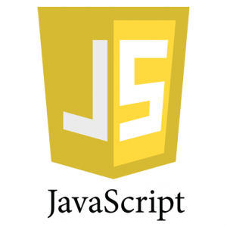
What is JavaScript
It is dynamic programming language.
It is client side script to interact with user.
It most commonly used as a part of web browser.

Slide 6
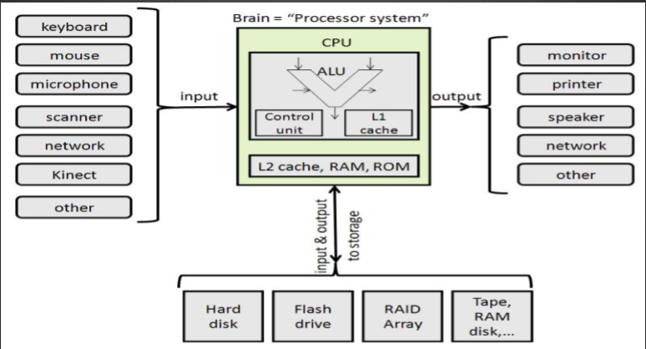
What is I/O
Distance of data travel from input to output

Slide 7
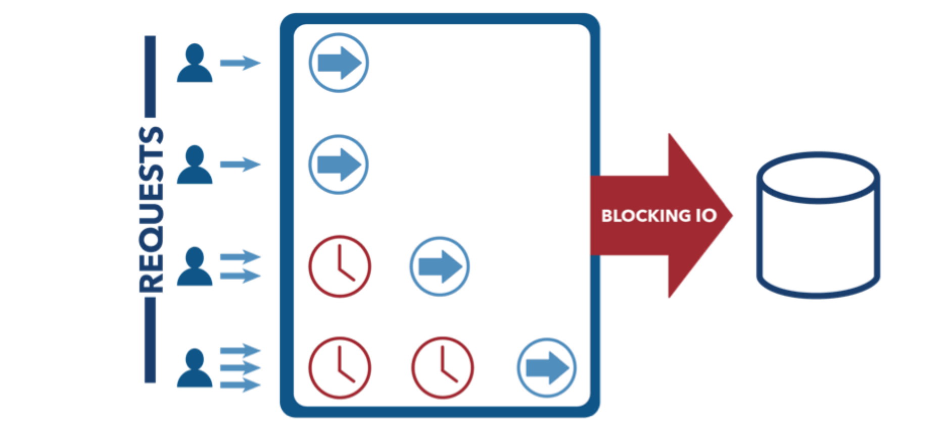
What is Blocking IO
Blocking IO waits for data to be read or written before returning. You can guarantee you always have some data.

Slide 8
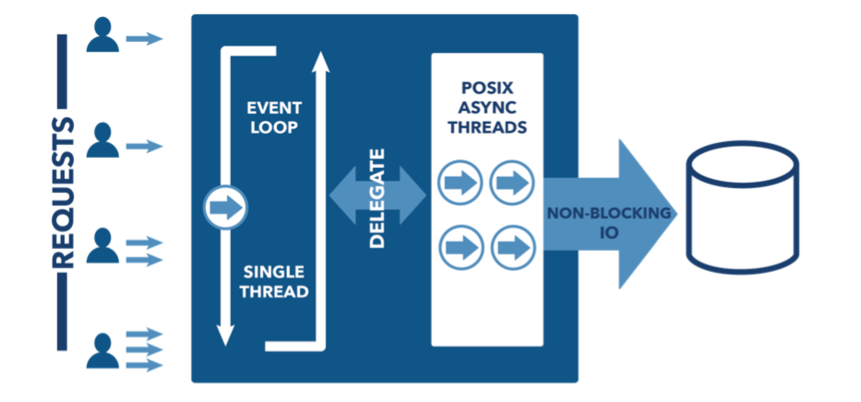
NON Blocking IO
Non blocking IO doesn’t block, and always returns ASAP even if this means you get no data.

Slide 9
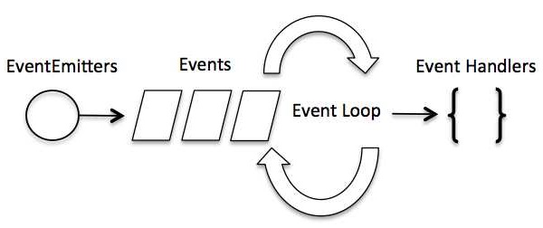
EVENT LOOP
Node.js is a single-threaded application, but it can support concurrency via the concept of event loop
Node starts its server, it simply initiates its variables, declares functions and then simply waits for the event to occur.
In an event-driven application, there is generally a main loop that listens for events, and then triggers a callback function when one of those events is detected.

Slide 10
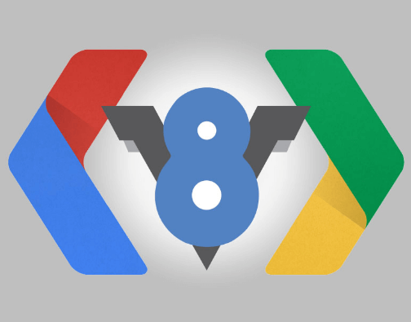
JavaScript V8 Engine
The V8 JavaScript Engine is an open source JavaScript engine developed by Google for the Google Chrome web browser.
V8 compiles JavaScript to native machine code (IA-32, x86-64, ARM, or MIPS ISAs) before executing it.

Slide 11
REASONS OF NODE.JS
It is very lightweight and fast
The counter is really easy to make to be real time.
Node.js was easy to configure.
There are lots of modules available for free.
Node.Js work with NoSQL as well.

Slide 12
NODE.JS SETUP
Download at http://nodejs.org/download/
Set Environment variable (Last version automatic set)
Open command line and type following.
node - v

Slide 13
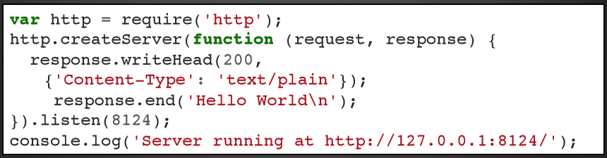
FIRST APPLICATION
Create example.js file and write code following.
Open Terminal then type node example.js

Slide 14
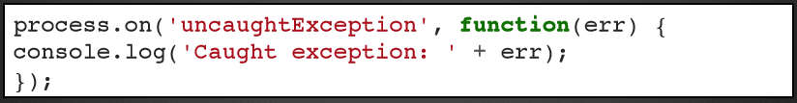
GLOBAL OBJECTS
These objects are available in all modules.
process - In computing, a process is an instance of a computer program that is being executed
console - For printing to stdout and stderr.
require - refer to external library.

Slide 15
What is NPM ?
NPM is a package manager for Node.js packages, or modules if you like.
NPM is a way to reuse code from other developers, and also a way to share your code with them, and it makes it easy to manage the different versions of code.
Node Package Manager (NPM) provides two main functionalities −
Online repositories for node.js packages/modules
Command line utility to install Node.js packages, do version management and dependency management of Node.js packages.

Slide 16
TOOLS OF NPM
NPM is made up of 3 distinct pieces: the website, the registry & the CLI.
The website serves as the primary tool for users to discover packages.
The registry is a large database of information about packages.
The CLI is how developers publish their packages on the registry or download packages they wish to install.

Slide 17
What do you mean by NPM ?
“npm” is a command line interface program to manage node.js libraries.
Why do we use NPM ?
l find lots of modules which can be used on the server side.
There are also lots of packages which add commands for you to use in the command line.
You'll also find packages which can be used on the front end.
How do I use NPM ?
Make sure you have Node and NPM installed by running simple commands to see what version of each is installed and to run a simple test program:
Test Node. To see if Node is installed, open the Windows Command Prompt and type “node –v” .
Test NPM. ...
Create a test file and run it.

Slide 18
NPM INSTALLATION
Installing Modules using NPM
There is a simple syntax to install any Node.js module −
- $ npm install <module_name>
To install latest version of NPM
- npm install npm@latest –g
Installing NPM Manually
https://registry.npmjs.org/npm/-/npm-{VERSION}.tgz

Slide 19
LOCAL INSTALLATION
NPM installs any dependency in the local mode.
Here local mode refers to the package installation in node_modules directory lying in the folder where Node application is present.
Locally deployed packages are accessible via require() method.
You can use ”npm ls” command to list down all the locally installed modules.
GLOBAL INSTALLATION
Globally installed packages/dependencies are stored in system directory.
Such dependencies can be used in CLI (Command Line Interface) function of any node.js but cannot be imported using require() in Node application directly.
Syntax - $ npm install <module_name> -g

Slide 20
Why Package.json ?
PACKAGE.JSON
The best way to manage locally installed npm packages is to create a package.json file.
A Package.json file offers you a lot of great things:
It serves as documentation for what packages your project depends on.
It makes your build reproducible, which means that it's much easier to share with other developers.
Requirements:
“Name” - all lowercase
- one word, no spaces
- dashes and underscores allowed
“Versions” – in the form of x.x.x

Slide 21
CREATION A PACKAGE.JSON
To create a package.json run > npm init
If you run the above command it will default JSON file.
Attributes of Package.Json :
name − name of the package
version − version of the package
description − description of the package
author − author of the package
contributors − name of the contributors to the package
Specifying Packages :
“Dependencies”: These packages are required by your application in production.
“DevDependencies”: These packages are only needed for development and testing.

Slide 22
Publishing NPM Packages
Creating a User
To publish, you must be a user on the npm registry. If you don't have one, create it with “npm adduser”.
If you created one on the site, use npm login to store the credentials on the client.
Test: Use “npm config ls” to ensure that the credentials are stored on your client.
Publishing the Package
Use npm publish to publish the package.
Updating the Package
When you make changes, you can update the package using
Syntax - npm version <update_type>

Slide 23
Updating the package
When you make changes, you can update the package using
Syntax - npm version <update_type>
This command will change the version number in package.json
After updating the version number, you can “npm publish” again.
Modifying Profile Settings from the Command Line :
To view and set profile properties from the Command Line Interface (CLI) :
npm profile get - To see your current profile settings
npm profile set <prop> <value>

Slide 24
MODIFING PROFILE SETTINGS
npm displays your profile settings in a table: npm get profile
You can set or modify the following profile properties from the command line
email
password
Full name
To set a password, type ‘npm set password'. npm will prompt for your current password, then prompt for you to set a new password.
To set other values, append them to the end of the line as shown:
NPM will prompt for credentials, then respond to confirm that the change has occurred: Set fullname to mohan ravi rohith
$npm profile set fullname mohan ravi rohith

Slide 25
THANK YOU

